Slide 1
Snake Game
Presenter:
Neeraj Naik 1811027
Vatsal Pathak 1811033
-OSTPL Mini Project

Slide 2
OUTLINE
1.Project Description
2.Functionalities
3.User Manual Link
4.Demo
5.Tools used

Slide 3
PROJECT DESCRIPTION
Snake is an older classic video game. It was first created in late 70s. Later it was brought to PCs. The game has been recreated using Tkinter GUI in python with exciting changes in the styling part..

Slide 4
The user controls a snake which continuously moves in the direction its’ head is facing. If the snake runs into one of the outer boundary walls or its’ own body, it will result in fatal injury to the snake and the player will lose the game as a result. An apple will always be spawned on the map, at a randomly generated location. The snake can eat apples by running over them. When the snake eats the apple that is on the map, the snake will grow 1 unit longer and another apple will appear in another randomly generated location. The goal of the game is to control the snake in such a way that it eats as many apples as possible (i.e. the snake grows as long as possible) without dying. This gets harder the larger the snake gets, because there will be less available space for the snake to move in its’ environment and the speed of the snake is increased, so the game gets very strategic as the snake approaches longer lengths..

Slide 5
FUNCTIONALITIES
SCORE
SNAKE
COLLISION

Slide 6
Score
Score is equivalent to the length of the snake, and is tracked using a global variable throughout the entire duration of the game. Since the starting length of the snake is 3, the score possible for a user to achieve is (total length of snake ) -3 .
High score is maintained for each game session played so that the users can compete with themself and try to improve their skills.

Slide 7
Snake
The way the program keeps track of the snake is through an array of ranges. The array is re-dimensioned every time the snake grows. Every time the snake moves in a direction, each index takes the value of the index prior to it. Then the range at index 0 takes on the value of the range of its current location, offset in which ever direction the head is facing.
It is worthy of noting that the entire snake is not painted at once, but rather only the head is painted and the rear is erased during each movement

Slide 8
Collision
The main method that the program determines is whether a collision is occurred or not.
There are two types of collisions that are checked for: If the collision is with food object , the length of the snake and the score of the user is incremented.
If the collision is with either the snake body or with the boundary wall, the snake dies and the game is over.

Slide 9
USER MANUAL
https://github.com/vatsal003/SnakeGame/blob/master/usermanual.docx

Slide 10
DEMO
http://people.wku.edu/peter.harlan996/tic-tac-toe.html
https://github.com/vatsal003/SnakeGame/blob/master/demo_snake_game.mp4

Slide 11
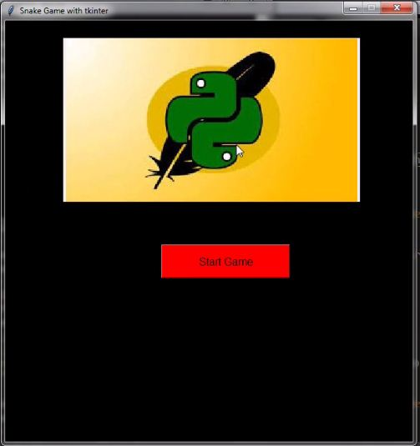
The game starts by clicking on the “Start Game” button on the screen.

Slide 12
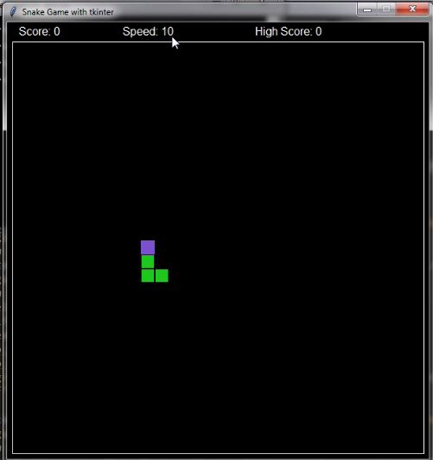
The snake can be controlled by the arrow keys. Depending on where you point them, the snake will go towards that direction.
The snake has to eat the food that appears on screen , which will increment the snake’s length and the user’s score.

Slide 13
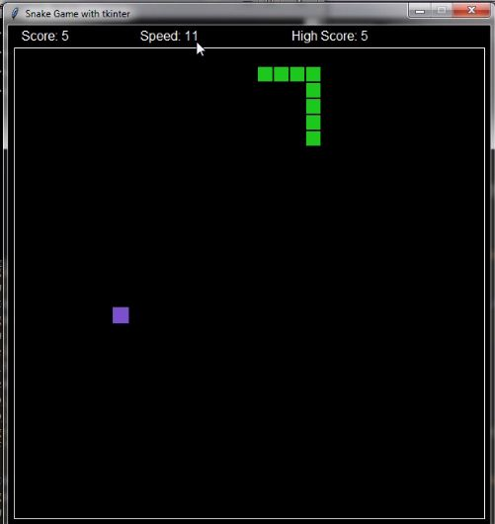
The speed of the snake is set to be initially 10 but as the game goes on for every increase of 5points the speed gets incremented by “1”.

Slide 14
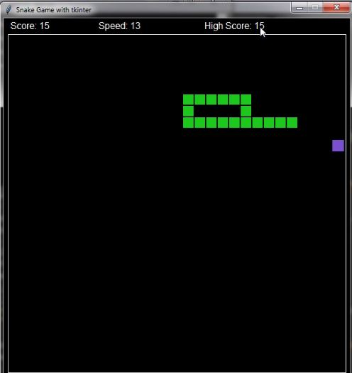
The game will come to an end if either the snake hits the wall or it hits itself.

Slide 15
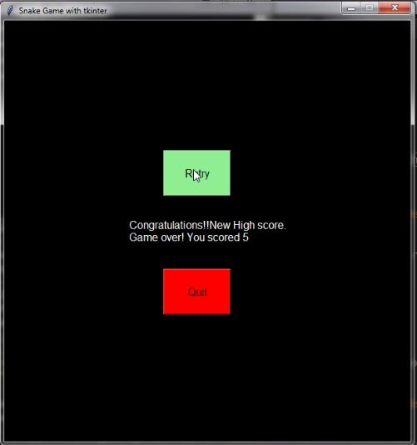
Once the game ends you’ll get a screen with your current score and the high score of that game session. Your high-score will be UPDATED if your current
score greater than your previous high-score. You will get two options either to restart or to end the game.

Slide 16
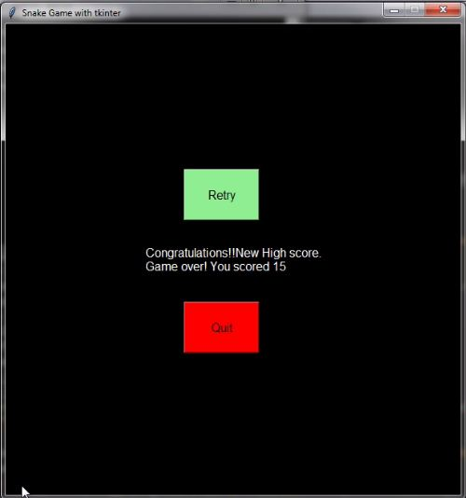
Once you decide to end the game you can click on quit option.

Slide 17
TOOLS USED
Pycharm IDE
Paint for images
Libraries used:
Pillow
Tkinter
functools

